Slide 1
Sit where you want for now but don’t move the seat Please put book bags under the table so that nobody trips on them thanks, the management

Slide 2
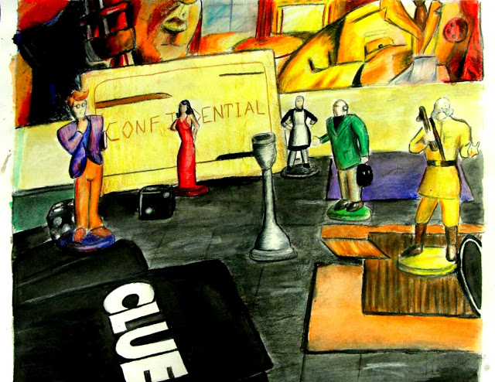
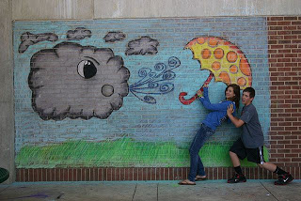
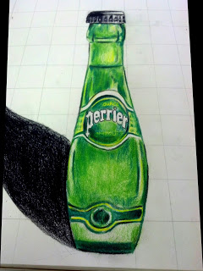
Art One

Slide 3
What Will We Do?
Develop Skills

Slide 4
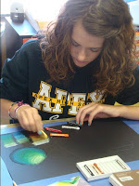
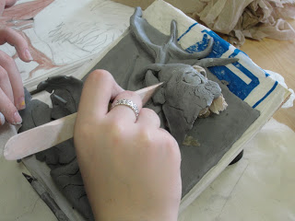
Skills
Observation – Sketchbook work

Slide 5
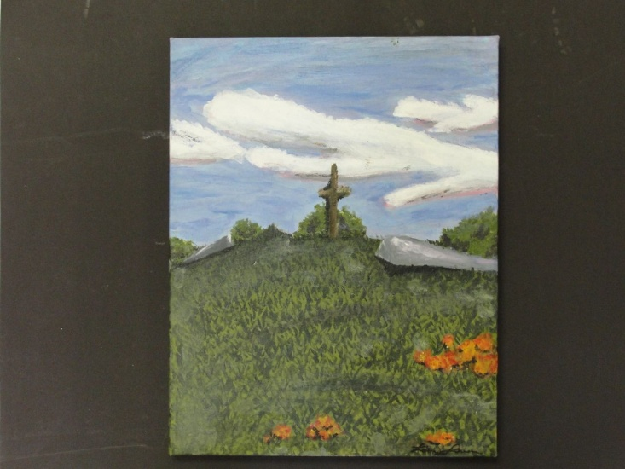
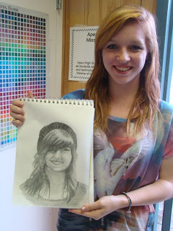
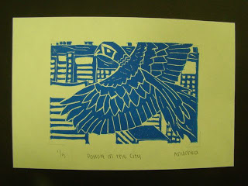
Skills
Drawing, Pastels, Printing, Perspective, Painting

Slide 6
What Will We Do?
Develop Skills
Incorporate Technology

Slide 7
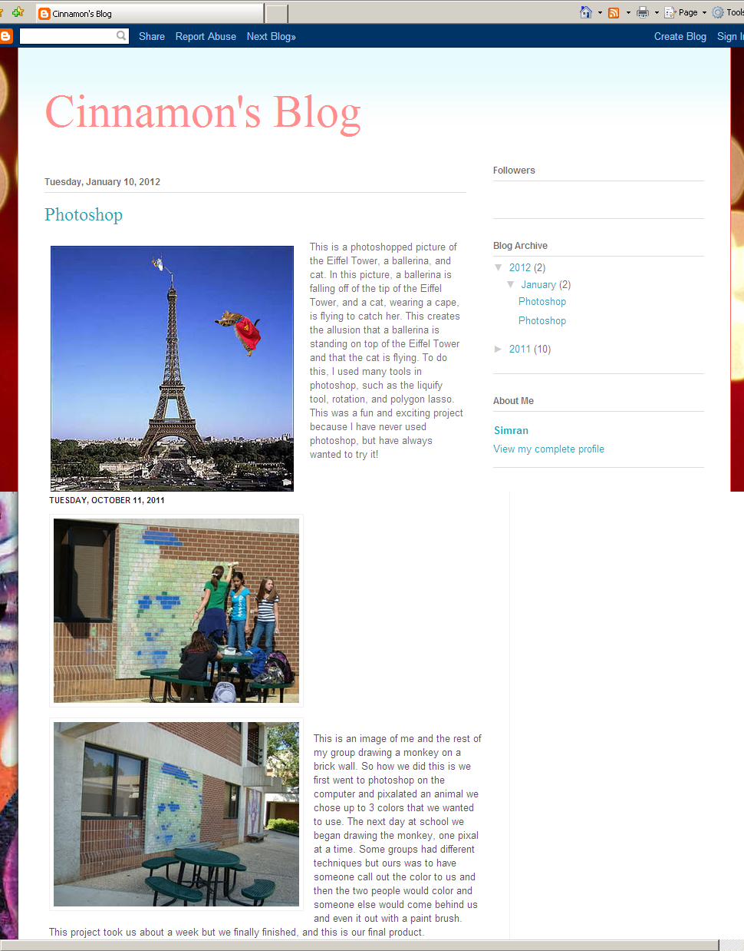
Maintain a Blog

Slide 8
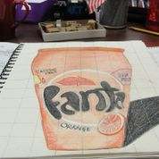
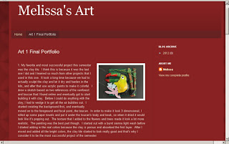
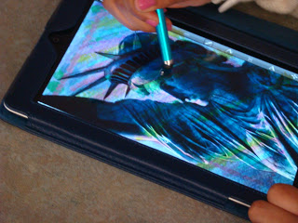
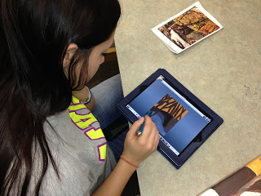
Technology

Slide 9
What Will We Do?
Develop Skills
Incorporate Technology
Work together - Collaboration

Slide 10
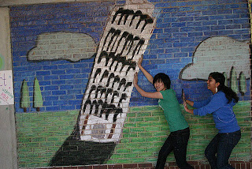
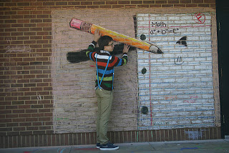
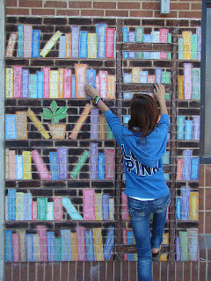
Collaboration
Working together to create something larger

Slide 11
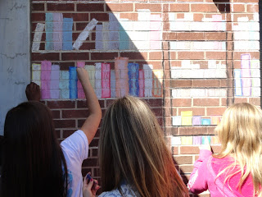
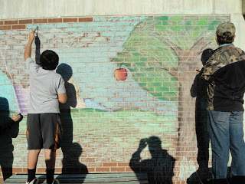
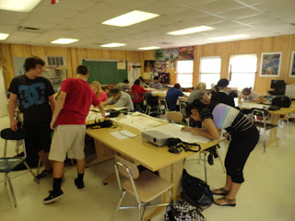
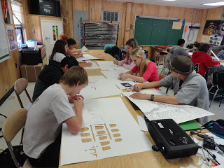
Collaboration

Slide 12
What Will We Do?
Develop Skills
Incorporate Technology
Work together - Collaboration
Go Beyond the Pencil

Slide 13
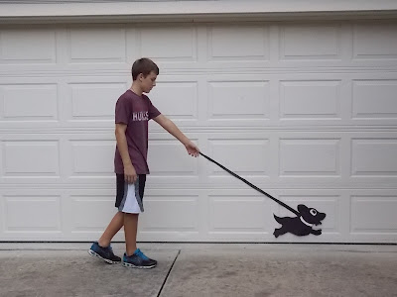
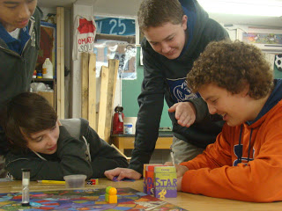
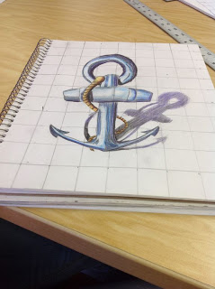
Beyond the Pencil

Slide 14
Supplies ASAP!
Supplies
1. Sketchbook (Spiral)
2. Hand held sharpener
3. Set of drawing pencils
4. Black Pen
5. Set of Colored Pencils
6. Soft pencil case
7. Canvas (11 x 14)
8. Paintbrush set (for Acrylics and watercolors)

Slide 15
Sketchbook Purpose
We will use sketchbooks for:
Basically Everything
Daily warm ups
Weekly sketchbook assignments
Weekly Journaling
All references for drawings
Sketches for each project
Vocabulary and important written information
Sketches are VERY important to an artist and their growth.

Slide 16
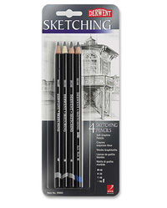
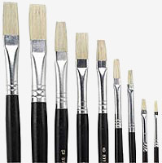
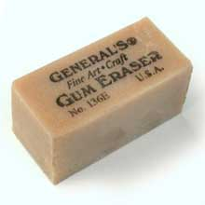
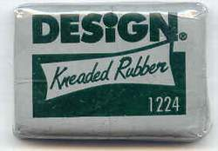
Art Room Supplies are located…

Slide 17
Sketchbook Grading
Sketchbook assignments
must be either
fully shaded or fully colored
Yes
Yes
Heck No!

Slide 18
Who Am I?

Slide 19
Web Sites
www.rossiartclass.weebly.com
www.artofapex.com

